Slide 1
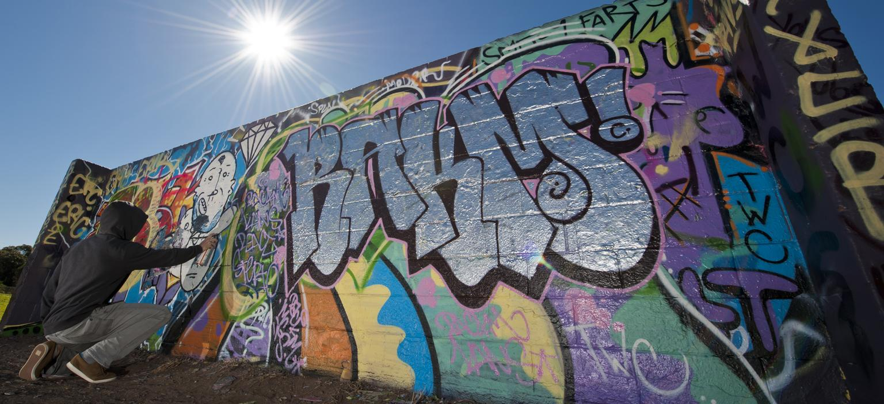
Graffiti Incident Tracking System (GITS)
Team: Michael Jannain, Julian Nunez, Jose Garcia, Jimmy Doan

Slide 2
Capabilities for GITS
An Internet portal that allows Central City Public Works personnel to document graffiti and send the incident data to the appropriate investigating law enforcement official.
User interface that will allow an investigating law enforcement official to view, edit, and update the incident data along with any photo(s) of the damage and identity of graffiti suspect(s).
Analysis capabilities that will allow law enforcement personnel to identify "hot spots".
Reporting capabilities that will allow authorized staff to request, view and/or print reports based on information in the database.

Slide 3
Methodology
Architected Agile - Small group size and lack of experience in software development/required languages among team members warrants extra focus towards foundations/architectural issues in the initial iteration. Transition to agile afterwards is perfect for current students who have other time commitments.

Slide 4
Project Manager: Mike
Scheduling:
Schedule split into 2 sections: 1) Design 2) Testing
Further broken up into Build 1-Build 3:
Build 1: City Worker related portions of the GITS database
Build 2: Law Enforcement related portions of the GITS database
Build 3: Sync Law Enforcement / City Worker sections
Here the databases will overlap and integrate, also system performance features relating to both Law Enforcement and City Workers will be included here
Unit-testing after each phase → Testing Phases after Build 1-3 finish
Graffiti Incident Documentation (Crew Info)
Crew ID and other cleanup details must be part of the MySQL database

Slide 5
Software Manager: Jimmy
Responsible for software requirement refinement, design, implementation, and integration.
Requirements Refinement: Requirements Database & Requirements Analysis
Software Design, Implementation, Integration:
Involved throughout:
Build 1 (For City Crew)
Build 2 (For Law Enforcement)
Build 3 (Syncing both Builds together)

Slide 6
Test Manager: Jose
City Workers
Image Upload
Law Enforcement
Update Graffitti Info
Image Upload
System and Performance
Validations of inputs
Entry and Processing of Names
Online Help
Screen/UI
Framework
Admin Menu
Reporting
Status Report

Slide 7
Configuration Manager: Julian
City Workers
Options
Law Enforcement
Ability to update Suspect Info
Graffiti Analysis (GA) Requirements (Frequency of Incidents)
Unit Testing
UI Performance
Operational Environment: Multiple Users
Security Access
Sorted Record of Incidents

